Slide 1
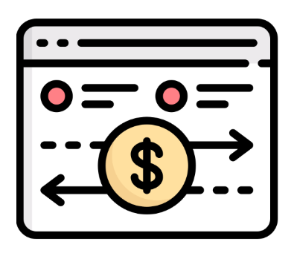




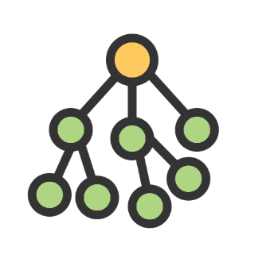
Exploit Scripts
simulate
Attack
Transactions
Raw Transaction Data
History Knowledge
Construction
sanitize
LLM
Summary
Metadata
+
Vector
Database
embed
Behavior
Traces
1. Preprocess
4.Select context
Below threshold:
omit retrieved cases
Prompt
2. Query &
Retrieval
Risk hint(p)
Attack probability
p(Attack)
5. Analyze
Pruned Target
Execution Trace Tree
Top-k case
Reference#1
summary&trace
Attack
XGBoost
...
Reference#k
summary&trace
LLM
Benign
3. Assess risk
Current transaction
Target execution
trace tree
DeFi Attack Detection

Slide 2
Exploit Scripts
simulate
Attack
Transactions
History Knowledge
Construction
sanitize
LLM
Raw Transaction Data
Summary
Metadata
Vector
Database
embed
Behavior
Traces
+
1. Preprocess
4.Select context
Pruned Target
Execution Trace Tree
2. Query &
Retrieval
Prompt
Risk hint(p)
5. Analyze
XGBoost
Attack probability
p(Attack)
Reference#1
summary&trace
Attack
Top-k case
3. Assess risk
Below threshold:
omit retrieved cases
...
Reference#k
summary&trace
LLM
Benign
Target execution
trace tree
DeFi Attack Detection
Current transaction

